Slide 1


Slide 2
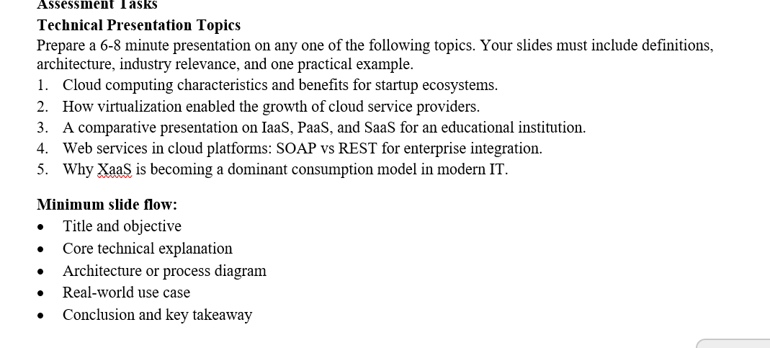

Slide 3
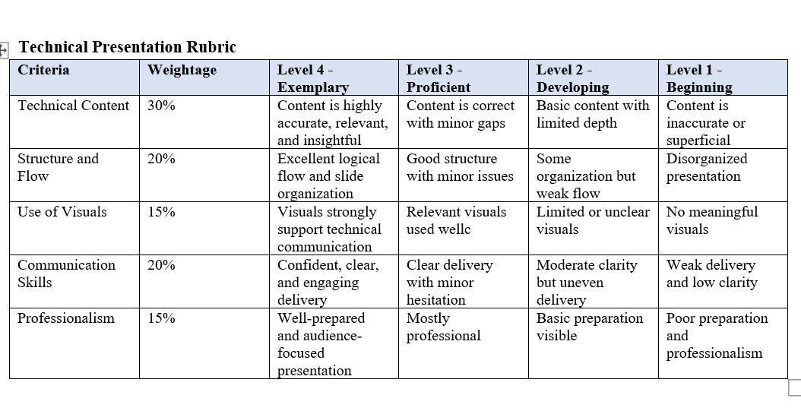

Slide 4

CO1-AT-2-TECHNICAL PRESENTATION
Cloud Computing Characteristics and Benefits for Startup Ecosystems
CSA1522-CLOUD COMPUTING AND BIG DATA ANALYTICS
GUIDED BY:
DR.P.RAJARAM
BY:
L.KEERTHANA –[192521062]
V.NANTHINI SRI-[192521344]
S.VAISHNAVI-[192521313]

Slide 5
INTRODUCTION
Cloud computing delivers computing resources over the internet.
It provides services such as storage, servers, and software on demand.
Startups can use cloud services without purchasing expensive hardware.
It helps businesses launch products quickly and efficiently.

Slide 6
CHARACTERISTICS OF CLOUD COMPUTING
KEY CHARACTERISTICS
On-Demand Self-Service – Resources are available whenever needed.
Broad Network Access – Services can be accessed from anywhere using the internet.
Resource Pooling – Multiple users share computing resources securely.
Rapid Elasticity – Resources can increase or decrease based on demand.
Measured Service – Users pay only for the resources they use.

Slide 7
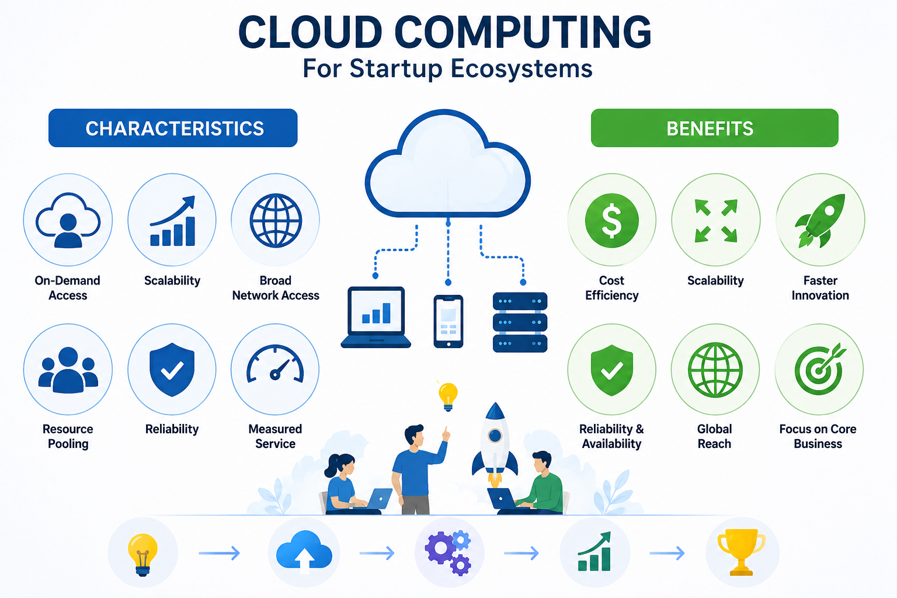

Slide 8
BENEFITS FOR STARTUP ECOSYSTEMS
BENEFITS
Reduces initial investment costs.
Enables faster product development and deployment.
Easily scales as the business grows.
Supports remote collaboration among teams.
Improves data backup and disaster recovery.
Encourages innovation with access to modern technologies.

Slide 9
APPLICATIONS AND CHALLENGES
Applications
Web and mobile application hosting.
Data storage and backup.
Software development and testing.
AI and Machine Learning services.
Business analytics.
CHALLENGES
Data security and privacy concerns.
Internet dependency.
Vendor lock-in.
Compliance with regulations.

Slide 10
FUTURE SCOPE
Cloud computing will help startups grow with lower infrastructure costs.
AI and IoT integration will create smarter cloud-based applications.
Cloud services will become more secure and efficient.
More businesses will adopt cloud technology for innovation and growth.

Slide 11
CONCLUSION
Cloud computing provides flexible and cost-effective IT resources.
Its characteristics make it ideal for startups with limited budgets.
It supports business growth through scalability and accessibility.
Cloud technology enables startups to innovate and compete effectively in the digital economy.

Slide 12
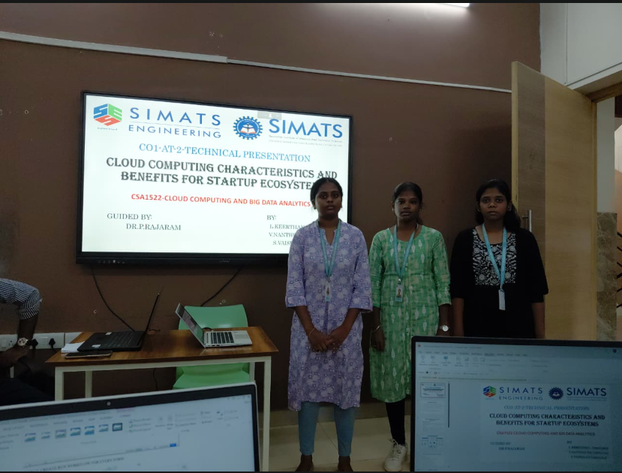

Slide 13
Thank you

